Slide 1
An Overview of Decision Support Systems
Notes:
Decisions support systems are people, procedures, software, databases, and devices that are used in problem-specific decision-making and problem-solving. Decision support systems are particularly useful when dealing with semi-structured, poorly structured, or unstructured situations. Although decision support systems are used most often at higher levels of management, all employees may use them to assist in even programmable decisions.

Slide 2
Capabilities of a Decision Support System (1)
Support for problem-solving phases
  Intelligence, design, choice, implementation, monitoring
Support for different decision frequencies
  Ad hoc DSS: Concerned with decisions that come up once in every 5 years (e.x., where should a company open a new distribution center?)
  Institutional DSS: Concerned with decisions that repeat (e.x., what should the company invest in?
Notes:
Although a specific DSS might only support one or a few phases, decision support systems can support decision makers in all the phases of the problem-solving process – that is, in the intelligence, design, choice, implementation, and monitoring stages.
As we’ve seen in this chapter, decisions can range from one-of-a kind to recurring. An ad hoc DSS is useful for one-of-a kind or less structured decisions, while an institutional DSS handles situations that happen on an ongoing basis. Institutional DSSs are refined over time. For instance, deciding where to locate a regional airport is likely a one of a kind decision, whereas investment decisions are recurring. Thus, a DSS can support decisions ranging from unstructured to structured.

Slide 3
Capabilities of a Decision Support System (2)
Support for different problem structures
  Highly structured problems: Known facts and relationships
  Semi-structured problems: Facts unknown or ambiguous, relations vague
  E.x.Which person to hire for a position?
Support for various decision-making levels
  Operational level: Daily decisions
  Tactical level: Planning and control
  Strategic level: Long-term decisions
Notes:
Although a specific DSS might only support one or a few phases, decision support systems can support decision makers in all the phases of the problem-solving process – that is, in the intelligence, design, choice, implementation, and monitoring stages.
As we’ve seen in this chapter, decisions can range from one-of-a kind to recurring. An ad hoc DSS is useful for one-of-a kind or less structured decisions, while an institutional DSS handles situations that happen on an ongoing basis. Institutional DSSs are refined over time. For instance, deciding where to locate a regional airport is likely a one of a kind decision, whereas investment decisions are recurring. Thus, a DSS can support decisions ranging from unstructured to structured.

Slide 4
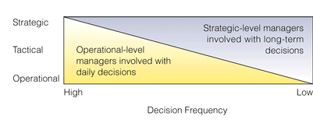
Support for Various Decision-Making Levels

Slide 5
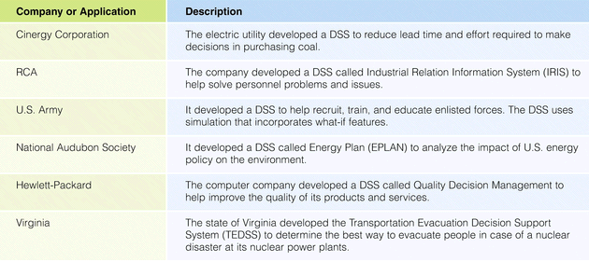
Selected DSS Applications

Slide 6
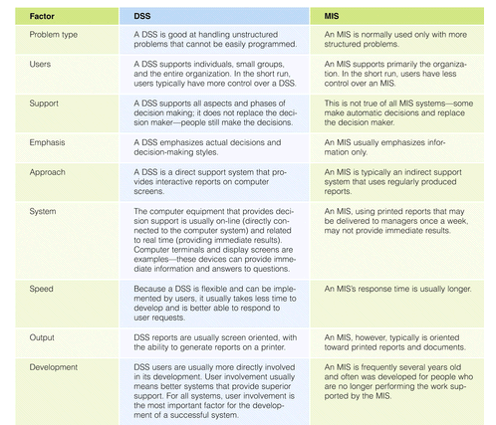
Comparison of DSSs and MISs

Slide 7
Components of a DSS
Notes:
Decision support systems are composed of several interrelated parts.

Slide 8
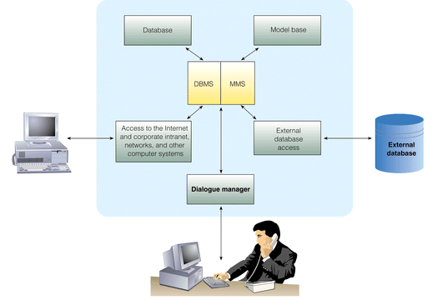
Conceptual Model of a DSS

Slide 9
The Database
Data in databases, data marts, warehouses
Use data mining to help with the decisions
Ex. Who should an airline target for flights from Istanbul to Ankara?

Slide 10
The Model Base
Decision makers perform quantitative analysis on data
Model base contains a list of models for mathematical computations
Model management system: Allows access to such models

Slide 11
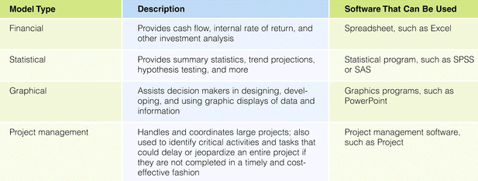
The Model Base

Slide 12
Group Decision Support Systems

Slide 13
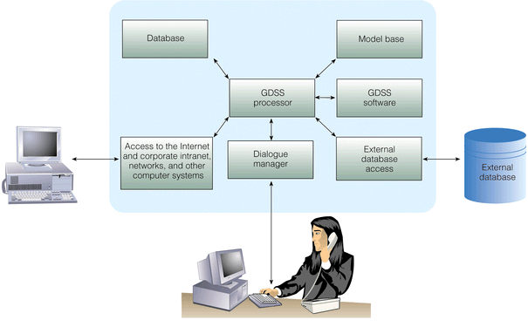
Configuration of a DSS

Slide 14
Characteristics of a GDSS (1)
Special design:
  Effective communication
  Group decision making
Ease of use
Flexibility
  Accommodate different perspectives
Anonymous input
  Individuals’ names are not exposed
Parallel communication
Notes:
GDSSs are designed to support effective group communication and good decision making techniques, as well as creative thinking.
As a general rule, any software that is hard to use, won’t be used. GDSS software must be especially user friendly, since often groups have less patience with bad software than do individuals.
Since different people may solve the same problem in different ways, a GDSS should support different approaches to decision-making, as well as integrate their output into a common view.
A GDSS supports group decision-making techniques, such as the Delphi approach, brainstorming, group consensus, and the nominal group technique.

Slide 15
Characteristics of a GDSS (2)
Decision-making support
  Delphi approach: Decision makers are scattered around the globe
  Brainstorming: Say things as you think---think out loud
  Group consensus approach: The group reaches a unanimous decision (everybody agrees)
  Nominal group technique: Voting
Reduction of negative group behavior
  A trained meeting facilitator to help with sidetracking
Automated record keeping
Notes:
GDSSs are designed to support effective group communication and good decision making techniques, as well as creative thinking.
As a general rule, any software that is hard to use, won’t be used. GDSS software must be especially user friendly, since often groups have less patience with bad software than do individuals.
Since different people may solve the same problem in different ways, a GDSS should support different approaches to decision-making, as well as integrate their output into a common view.
A GDSS supports group decision-making techniques, such as the Delphi approach, brainstorming, group consensus, and the nominal group technique.

Slide 16
Examples of GDSS Software
Lotus Notes
  Store, manipulate, distribute memos
Microsoft Exchange
  Keep individual schedules
  Decide on meeting times
NetDocuments Enterprise
  Two people can review the same document together
Notes:
GDSSs are designed to support effective group communication and good decision making techniques, as well as creative thinking.
As a general rule, any software that is hard to use, won’t be used. GDSS software must be especially user friendly, since often groups have less patience with bad software than do individuals.
Since different people may solve the same problem in different ways, a GDSS should support different approaches to decision-making, as well as integrate their output into a common view.
A GDSS supports group decision-making techniques, such as the Delphi approach, brainstorming, group consensus, and the nominal group technique.

Slide 17
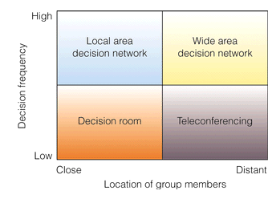
GDSS Alternatives

Slide 18
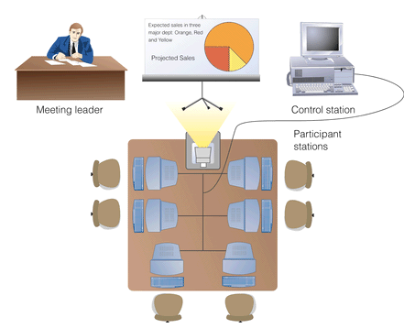
The GDSS Decision Room

Slide 19
Executive Support Systems
Notes:
Executive support systems, or executive information systems, were developed to provide senior managers the type of information they need, in the format that they need it. Executive support systems include a DSS, as well as other tools, such as office automation.

Slide 20
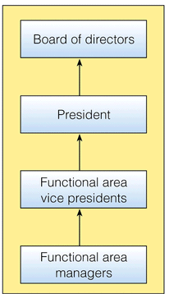
The Layers of Executive Decision Making

Slide 21
Executive Support Systems (ESS) in Perspective
Tailored to individual executives
  Not to managers in other levels
Easy to use
Drill down capabilities
Support need for external data
Can help when uncertainty is high
Future-oriented
Linked to value-added processes
Notes:
Although executive support systems have much in common with decision support systems, they have important differences. Generally, a DSS provides a number of modeling tools and is designed to help a user answer a question. Executive support systems allow executives to ask the right questions. An ESS is interactive and helps an executive focus, filter and organize data and information.
Unlike a DSS, an ESS is usually customized for a specific individual. Content and format can both be customized.
Since executives are typically busy, an ESS must be easy to learn and to use – or it won’t be used.

Slide 22
Capabilities of an ESS (1)
Support for defining an overall vision
  Organization’s product lines and services
Support for strategic planning
  Predict future trends
  Analyze merger possibilities
Support for strategic organizing & staffing
  Choice of departments
  Pay raises
Notes:
Most executive support systems are designed to give the user a top-down view of business processes and allow him to drill down to greater levels of detail. This capability, as well as access to external databases and to DSS modeling tools, allows top-level managers to work on long term, strategic issues that affect the whole company.

Slide 23
Capabilities of an ESS (2)
Support for strategic control
  Monitor and manage the overall organization
Support for crisis management
  Put together a contingency plan
Notes:
Most executive support systems are designed to give the user a top-down view of business processes and allow him to drill down to greater levels of detail. This capability, as well as access to external databases and to DSS modeling tools, allows top-level managers to work on long term, strategic issues that affect the whole company.

Slide 24
Summary
Decision-making phase - includes intelligence, design, and choice
Problem solving - also includes implementation and monitoring
Decision approaches - optimization, satisficing, and heuristic
Management information system - an integrated collection of people, procedures, databases, and devices that provide managers and decision makers with information to help achieve organizational goals

Slide 25
Summary
Decision support system (DSS) - an organized collection of people, procedures, software, databases, and devices working to support managerial decision making
Group decision support system (GDSS) - also called a computerized collaborative work system, consists of most of the elements in a DSS, plus software needed to provide effective support in group decision-making settings
Executive support systems (ESSs) - specialized decision support systems designed to meet the needs of senior management

